Slide 1
Recycling project competition top 10 winner’s prize giving ceremony

Slide 2
10th place giovanni

Slide 3
9th place taffael darius anthony

Slide 4
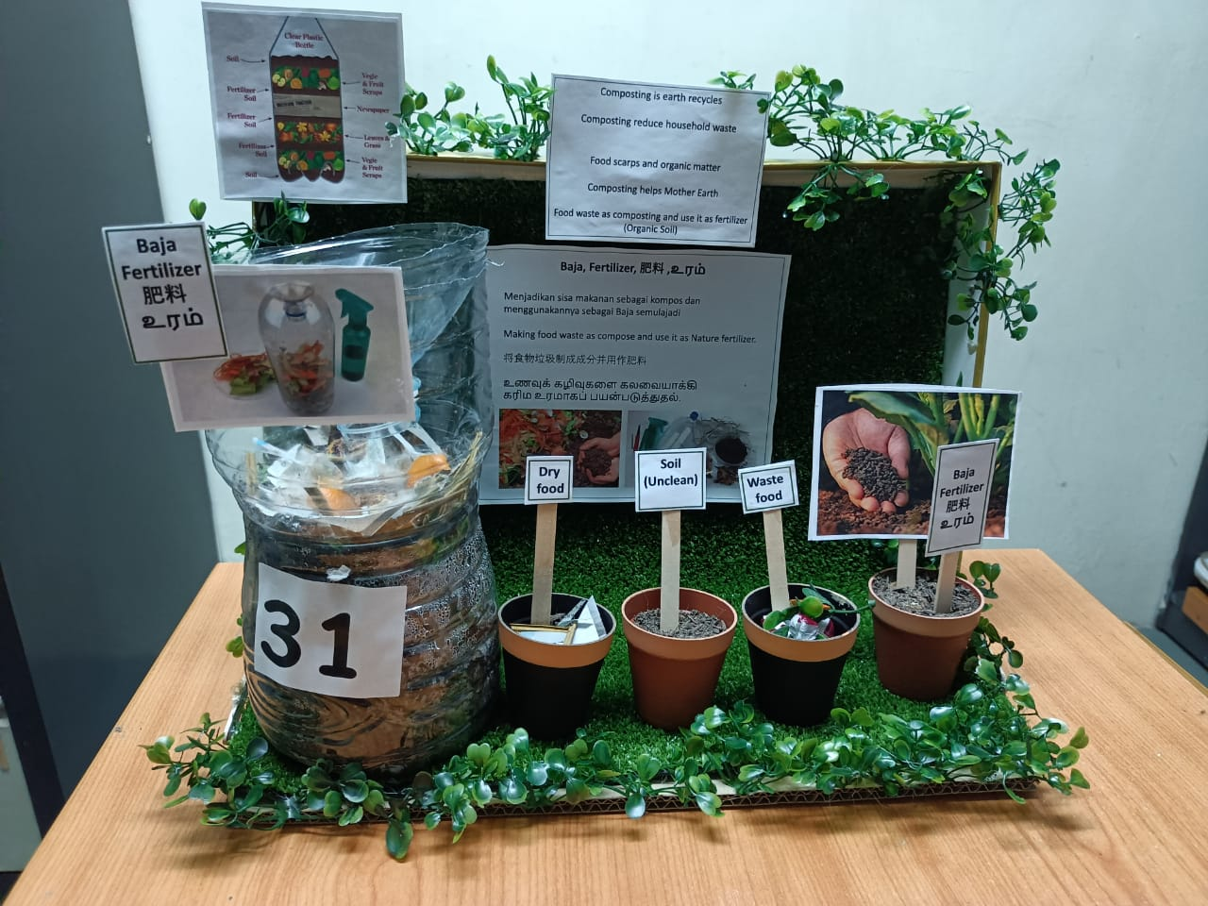
8th place preshan albert

Slide 5
7th place Rachel wong

Slide 6
6th place sherly maria

Slide 7
5th place jashaantiran joel

Slide 8
4th place presha albert

Slide 9
3rd place Camilo kevin

Slide 10
2nd place Prisca sharne albert

Slide 11
1st place Gregory elias

